Slide 1
Reusable Review Energy Hotel Recommender
By Steven Ta
Github: steventa87/Hotel_Recommendation
Linkedin: ta-steven

Slide 2
Problem
Most people look at star ratings and maybe read a couple reviews
No one has time to read hundreds or thousands of reviews
User reviews are often a wasted resource
How can we use customer reviews for smart search?

Slide 3

Hotel Data
San Francisco - 230 hotels, 30K reviews
Las Vegas - 230 hotels, 26K reviews
New York - 260 hotels, 55K reviews
User reviews without their star ratings

Slide 4
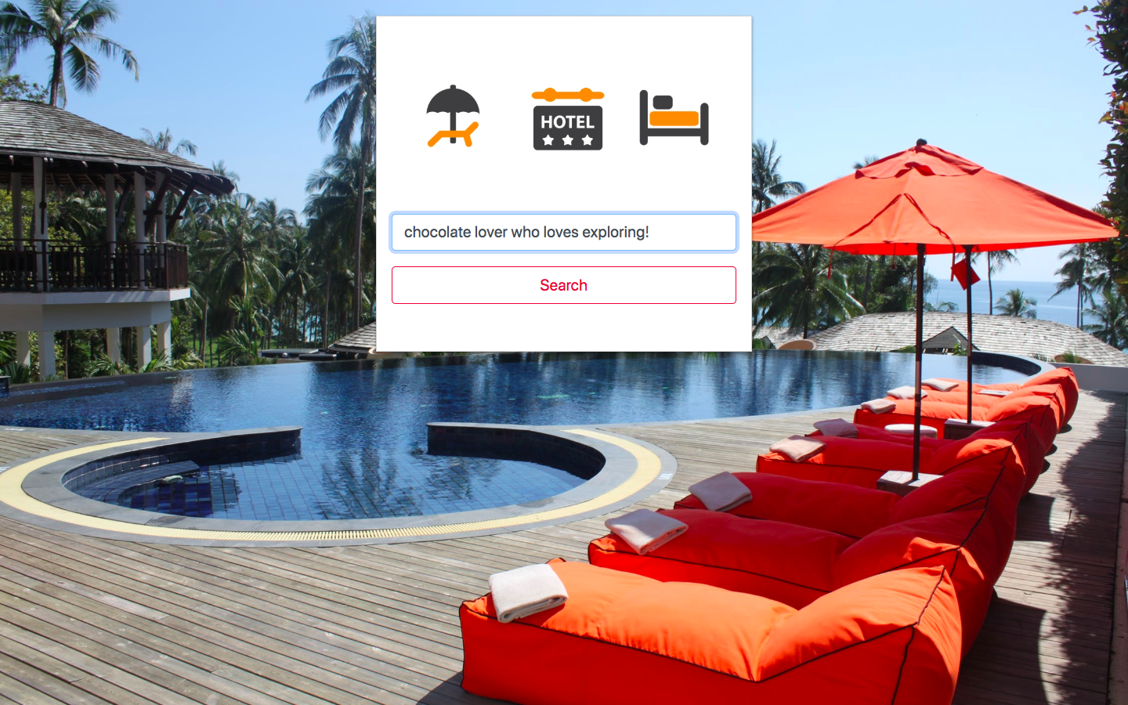
Web Application

Slide 5
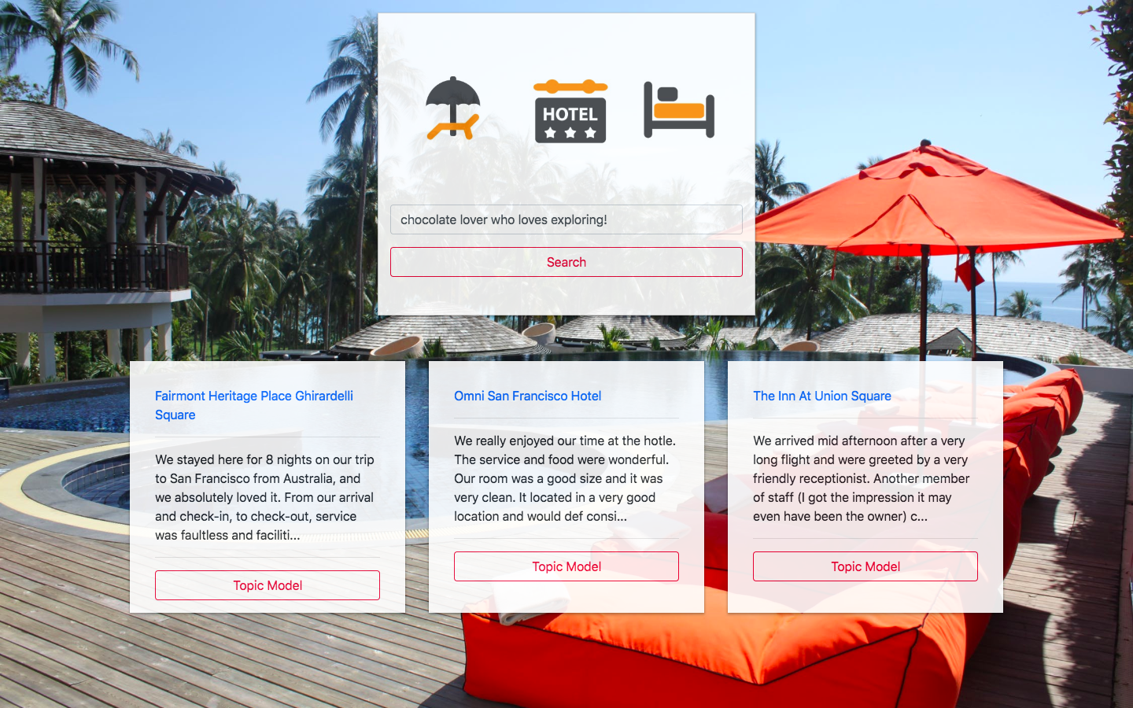
Smart search

Slide 6
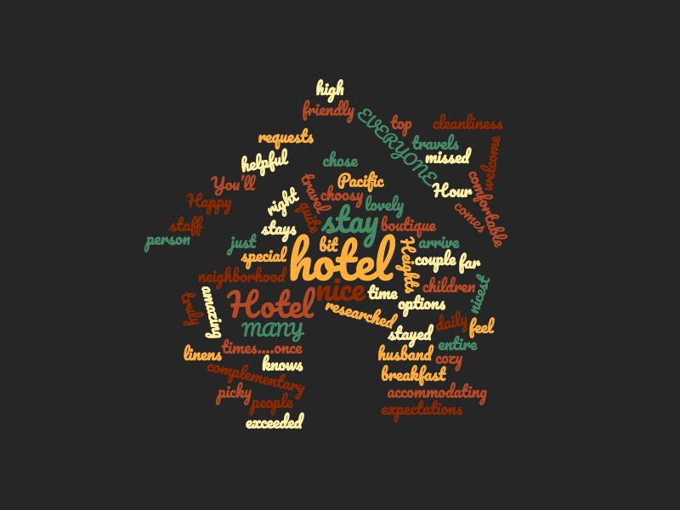
Content Based Recommendation
How it works
Search your
experience
TF-IDF
Cosine Similarity
Vectorize
Recommendation

Slide 7
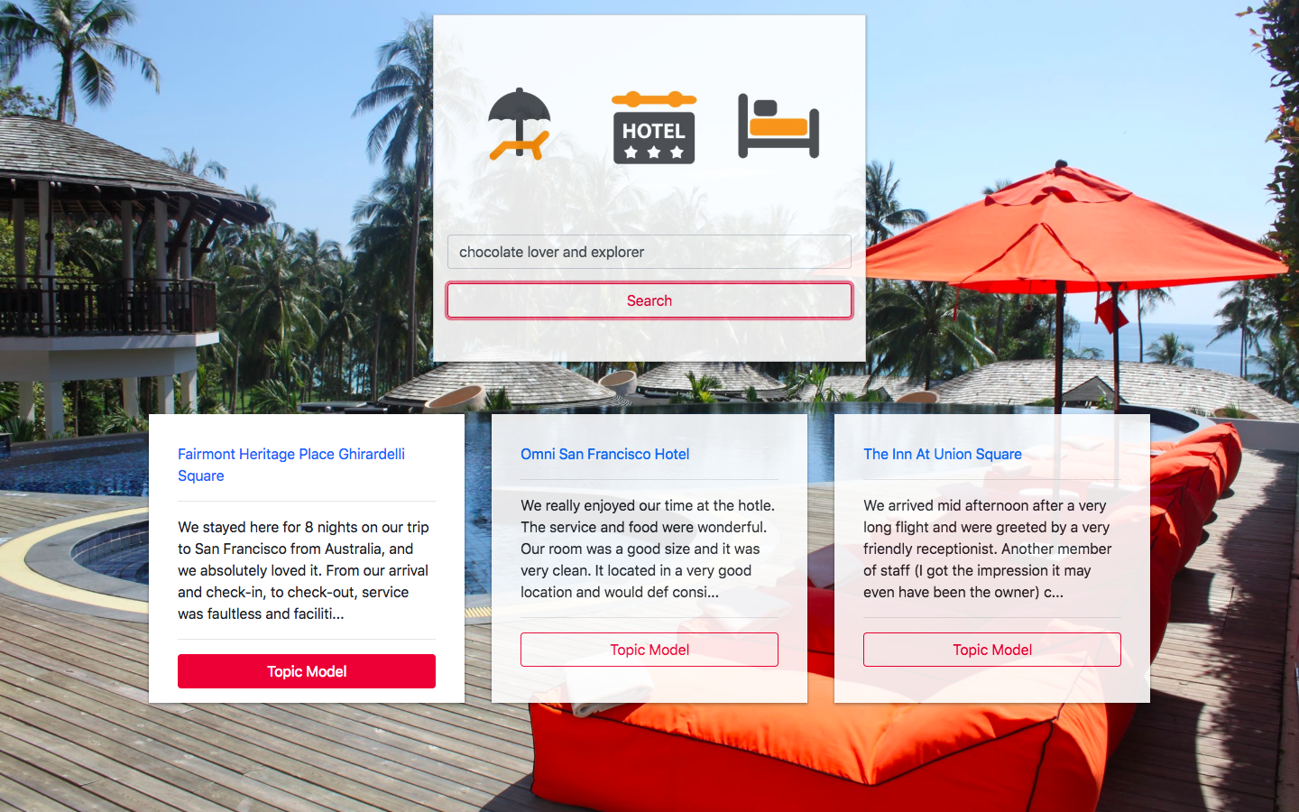
But What other insights can we find? Let’s topic model

Slide 8

Sentiment Topic Modeling
Hotel
Reviews
Positive
Neutral
Negative
Topic Analysis
Topic Analysis
Topic Analysis

Slide 9
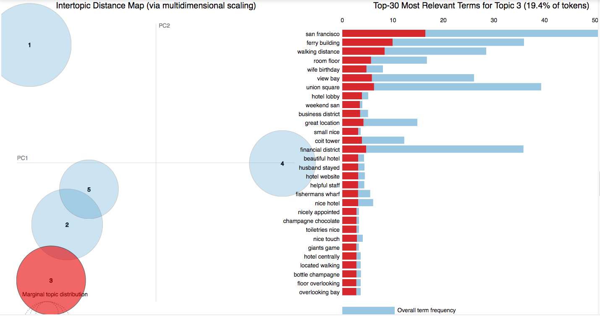
Unsupervised Topic Modeling
Cleanliness
Rooms
Service
Value
Location

Slide 10
Next Steps
To better validate recommendations, use reviews to predict how many stars a hotel has.
To improve topic analysis, experiment with many more words. For example, for efficiency, I limited my TF-IDF matrix from 200k words to 5k.

Slide 11
Thanks for Dropping by!
Steven Ta
Github: steventa87
linkedin.com/in/ta-steven

